Slide 1
Software Project
CECS 544
Spring 2024

Slide 2
Project Teams
No student may do the project solo.
A team of at least 2 people and no more than 3 is required.
The project is likely to required many hours of cooperative work.
You may pick your own teammates. An assignment for this task follows.
If you desire, a teammate will be assigned for you by me.

Slide 3
Bughound Bug Tracking Software
Our project is a scaled back version of a product I developed a long time ago for a little company (now defunct) in Bellevue, WA.
The main point of the project is to have a common basis for testing on a reasonable scale of a product you are familiar with.
Our testing will primarily be “black-box” with focus on correctly delivered functionality.
We will also conduct testing on security, structure, usability, navigation, and compatibility with multiple host configurations. And some technical testing we will learn in Unit 4 (data flows and anomalies)

Slide 4
Bughound Bug Tracking Software
Bughound is a secure (authorized users and login required) web-based bug recording and tracking software product
Key Features:
Using web browser, create, edit and update “bug” reports on multiple products
Store error report content in relational tables
Access error report content via SQL
Search for bugs on multiple fields
Facilities to add, delete or update information on program, releases, functional areas, employees, more

Slide 5
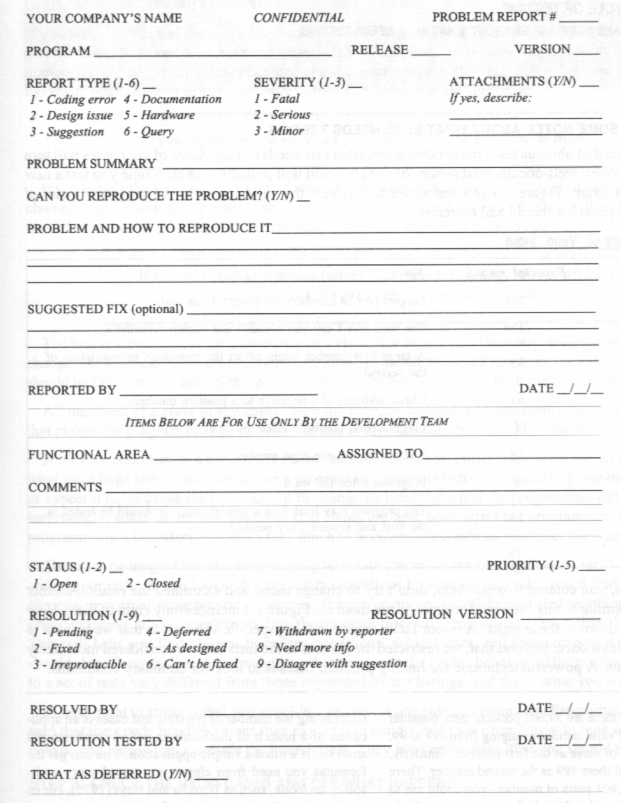
Bughound Content
Bughound content is based on this form from Testing Computer Software, 2nd Edition, Kaner, Falk and Nguyen (see Syllabus)
As with most forms, it translates easily to a web page or pages.
Some fields, for example REPORT TYPE can be simple listboxes.
Some fields are plain test (PROBLEM SUMMARY)
Some require links to external files (ATTACHMENTS)
For initial submission of a bug report, only fields up to REPORTED BY and DATE are used.

Slide 6
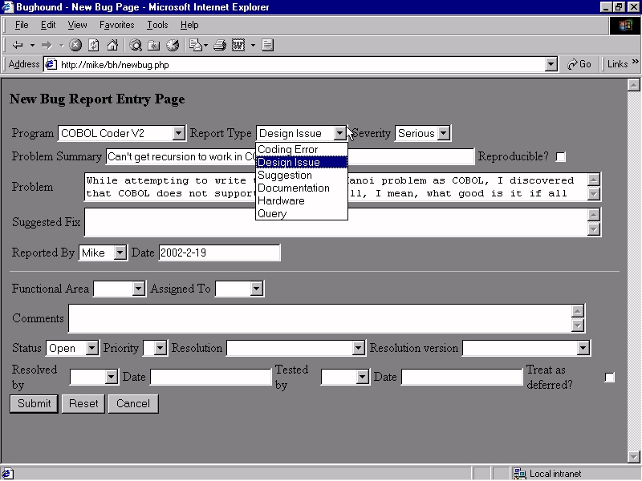
The Report in Software
Notes:
6

Slide 7
Bughound Details
Searchable fields
Program
Report Type
Severity
Functional Area
Assigned To
Status
Priority
Resolution
Reported By
Report Date
Resolved By
Autogenerate bug ID
Attach to report
Images
Memory dumps
Text files
Dynamic fields
Release and version data correspond to program change
One bug per report
Validate input
Export bug data to ASCII or XML

Slide 8
Implementation
Must be web browser based
Must use a sql database for all bug data, program data, employee data, area data
You must HAND CODE the project
You may use netbeans, eclipse, or Visual Studio
It will require server and client scripting such as php or asp and javascript or something from the 21st century.

Slide 9
Due Dates
March 1 –
ER diagram for all DB elements
UML deployment diagram
March 15
use cases for
create a new bug report
updating an existing bug report
management functions for the DB including
adding, updating, or deleting programs, areas, employees,
April 17 – finished product ready for testing

Slide 10
Contents of the Problem Report
Problem Report Number - unique
Program - your company may write many
Version - Release and Version
necessary because the problem may not be reproducible in other versions
prevents confusion as to whether the bug was from a fixed version or the fix failed
Notes:
10

Slide 11
Contents of the Problem Report
Report Type
Coding Error - program may work as designed
Design Issue - program works as intended, but design is in question
So? AS long as it works, what’s the problem?
Suggestion - just an idea to improve the program
Documentation - doesn’t behave as described in the manual or feature is not documented
Hardware - when the program fails on some specific type of hardware
Query - program behavior is unexpected
Notes:
11

Slide 12
Contents of the Problem Report
Severity - indicates the opinion of the reporter as to the seriousness of the problem
Beizer rates from 1 to 10 (Mild to Infectious)
Fewer levels the better (Minor, Serious, Fatal)
Minor errors tend not to be fixed. But many minor errors affect software quality as seen by users.
Annoyances (too many steps, menus too deep) may be minor to the programmer, but major to users
Notes:
12

Slide 13
Contents of the Problem Report
Attachments - printouts, memory dumps, memos, macros
Problem Summary - one or two line summary. “Program crashes when commission less than 1%.”
Can You Reproduce the Problem? - Yes, No, Sometimes. If the answer is No, many programmers ignore the report. If Yes, you may have to demo for the coders
Notes:
13

Slide 14
Contents of the Problem Report
Problem and How to Reproduce It
explain why it is a problem. Describe all steps and symptoms including error messages
Be careful to describe how to reproduce the problem. Programmers ignore bugs they can’t reproduce.
Better to fail reproducing now, than after you’ve reported the bug
Even if you can’t reproduce it, describe all the steps taken to do so, and report the problem anyway
Notes:
14

Slide 15
Contents of the Problem Report
Suggested Fix - optional. Programmers are not always able to imagine the fix (especially GUI issues)
Reported By - Programmer must be able to contact the reporter if can’t understand the issue. Also used for tacking tester productivity.
Date - date the problem was discovered, not the date of the report. Helps to identify the version
Notes:
15

Slide 16
Contents Problem Report
The following are required in Bughound but not required to submit a report. That is, they may be left blank upon report submission.*
Functional Area - Everyone uses the same list
Assigned To - group or manager responsible for fixing the problem
Comments - in paper systems, a brief statement on how the problem was fixed. In software trackers, can be a running commentary, discussion, feedback from testers, coders, managers
Notes:
16

Slide 17
More Contents Problem Report
As previous, required but optional*
Status - Open, Closed or Open, Closed, Resolved
Priority - assigned by manager
Fix immediately
Fix as soon as possible
Fix before next milestone
Fix before release
Fix if possible
Optional
Notes:
17

Slide 18
More Contents Problem Report
As before, required but optional*
Resolution and Resolution Version - current status
Pending
Fixed
Cannot be reproduced
Deferred
As designed
Withdrawn by reporter
Need more info
Disagree with suggestion
Duplicate
Notes:
18

